Slide 1
Multiple Regression Part 1
STAT 441/541 Statistical Methods II

Slide 2
Objectives of Part 1
Decide on the dependent variable and independent variables
Decide on the form of the multiple regression model
State the multiple regression model and describe all terms in the model
State the assumptions of multiple regression analysis
Interpret scatterplot and correlation matrices
Interpret estimates of partial slope parameters of the multiple regression model
Use the five-step method for the overall F test of a multiple regression model
Use the five-step method to test parameters of the multiple regression model

Slide 3
Sections Covered for Part 1
Special Topic: Scatterplot and Correlation Matrices
Chapter 13
13.3 Formulating the Model
Chapter 12
12.1 Introduction
12.3 Estimating Multiple Regression Coefficients
12.4 Inferences in Multiple Regression
Chapter 11
11.1 Introduction and Abstract of Research Study
Transformations

Slide 4
Scatterplot Matrix
A set of scatterplots for each pair of variables
Used to examine the relationship between each pair of variables
Linear
Nonlinear
Outliers
Examine relationship between dependent variable and all independent variables
Examine relationship between each pair of independent variables

Slide 5
Correlation Coefficients
A Pearson correlation coefficient for each pair of variables
Use p-values to identify significant correlations
Examine correlations between dependent variable and all independent variables
Examine correlations between each pair of independent variables
Used along with scatterplots to help build a multiple regression model

Slide 6
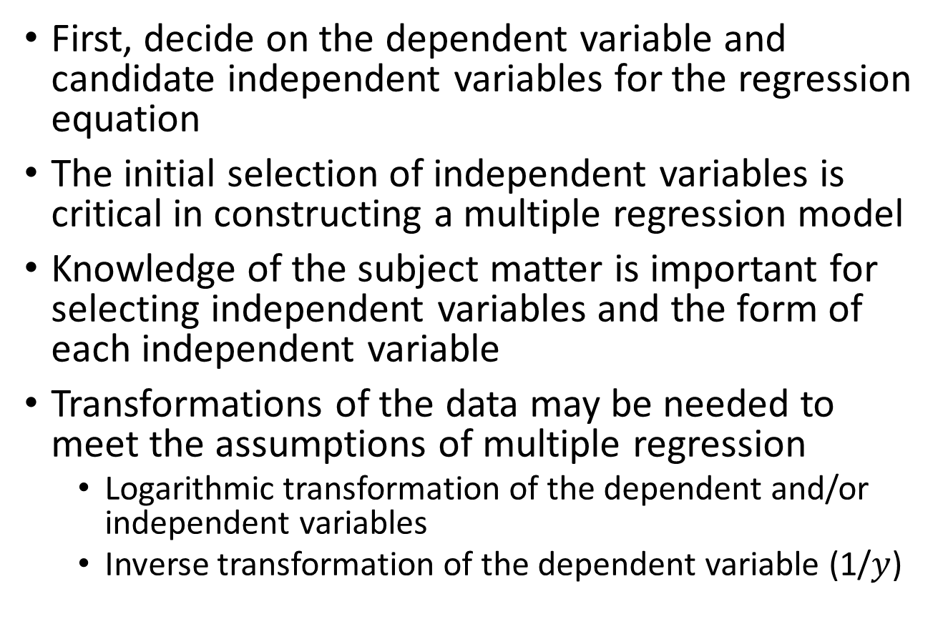
Section 13.3 Formulating the Model
First, decide on the dependent variable and candidate independent variables for the regression equation
The initial selection of independent variables is critical in constructing a multiple regression model
Knowledge of the subject matter is important for selecting independent variables and the form of each independent variable
Transformations of the data may be needed to meet the assumptions of multiple regression
Logarithmic transformation of the dependent and/or independent variables
Inverse transformation of the dependent variable (1/$y$)

Slide 7
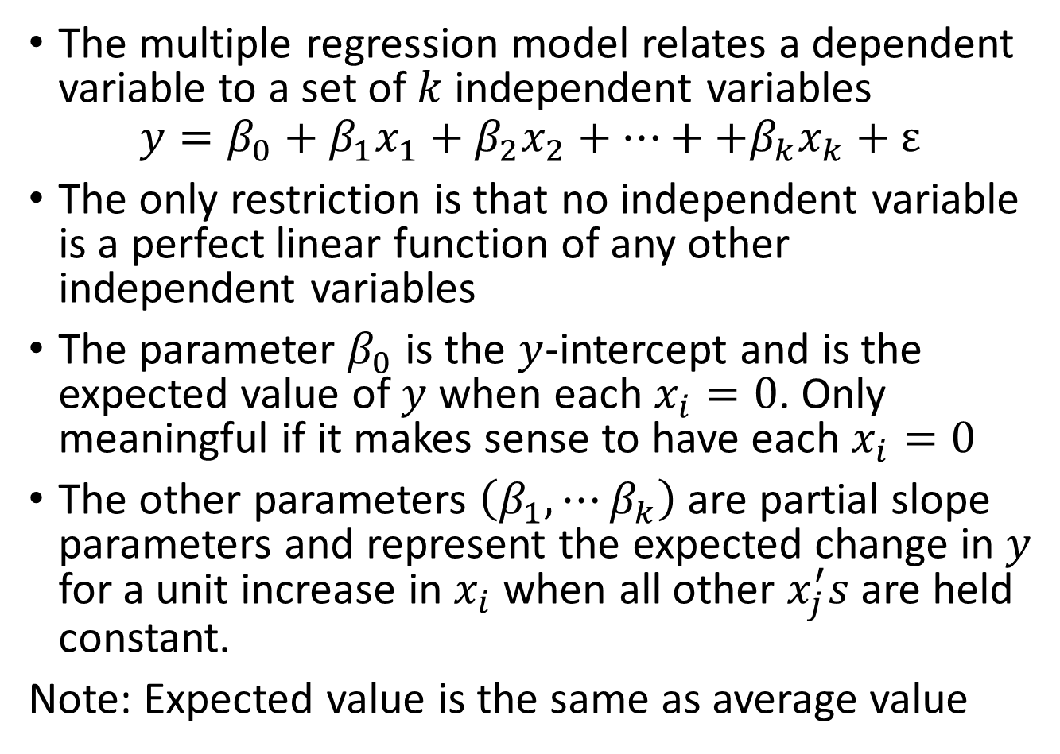
Section 12.1 Introduction
The multiple regression model relates a dependent variable to a set of $k$ independent variables
$$y=β_{0}+β_{1}x_{1}+β_{2}x_{2}+⋯++β_{k}x_{k}+ε$$
The only restriction is that no independent variable is a perfect linear function of any other independent variables
The parameter $β_{0}$ is the $y$-intercept and is the expected value of $y$ when each $x_{i}=0$. Only meaningful if it makes sense to have each $x_{i}=0$
The other parameters $\left(β_{1},⋯β_{k}\right)$ are partial slope parameters and represent the expected change in $y$ for a unit increase in $x_{i}$ when all other $x_{j}^{′}s$ are held constant.
Note: Expected value is the same as average value

Slide 8
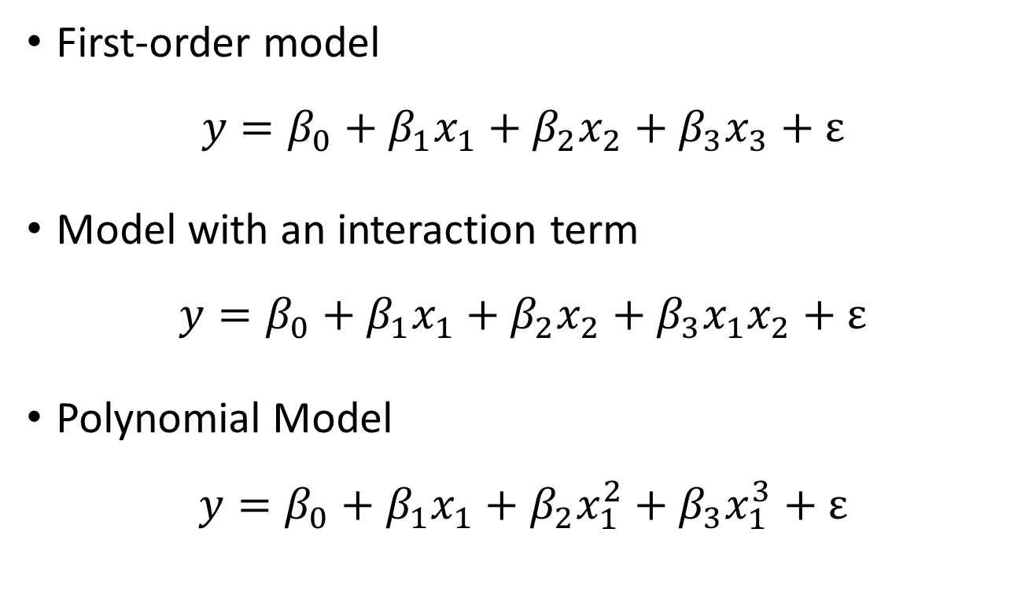
Examples of Multiple Regression Models
First-order model
$$y=β_{0}+β_{1}x_{1}+β_{2}x_{2}+β_{3}x_{3}+ε$$
Model with an interaction term
$$y=β_{0}+β_{1}x_{1}+β_{2}x_{2}+β_{3}x_{1}x_{2}+ε$$
Polynomial Model
$$y=β_{0}+β_{1}x_{1}+β_{2}x_{1}^{2}+β_{3}x_{1}^{3}+ε$$

Slide 9
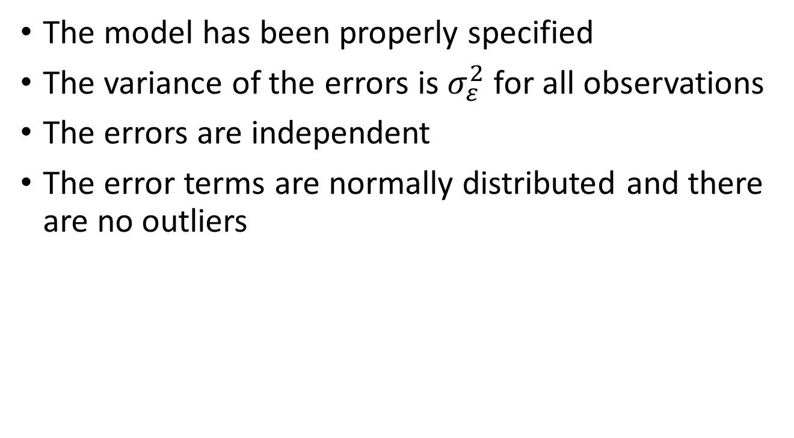
Assumptions for Multiple Regression
The model has been properly specified
The variance of the errors is${ σ}_{ε}^{2}$ for all observations
The errors are independent
The error terms are normally distributed and there are no outliers

Slide 10
Some Limitations of Regression Analysis
The existence of a relationship does not imply that changes in the independent variables cause changes in the dependent variable (cause and effect)
Do not use an estimated regression equation for extrapolation outside the range of values for all independent variables

Slide 11
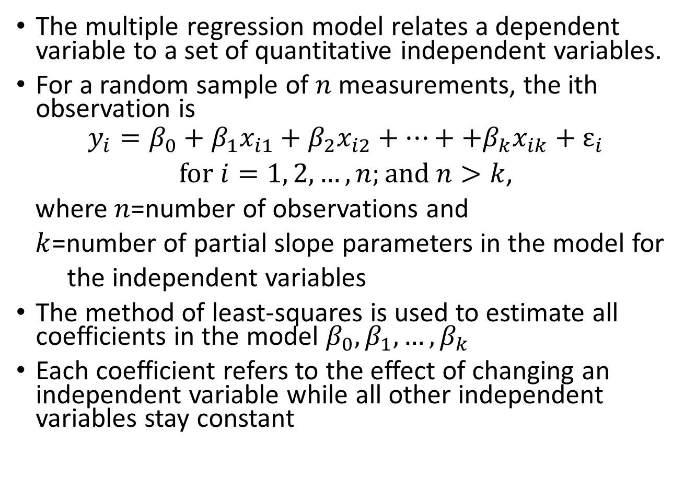
Section 12.3 Estimating Multiple Regression Coefficients
The multiple regression model relates a dependent variable to a set of quantitative independent variables.
For a random sample of $n$ measurements, the ith observation is
$$y_{i}=β_{0}+β_{1}x_{i1}+β_{2}x_{i2}+⋯++β_{k}x_{ik}+ε_{i}$$
$for i=1, 2, …,n;and n>k$,
where $n$=number of observations and
$k$=number of partial slope parameters in the model for
the independent variables
The method of least-squares is used to estimate all coefficients in the model $β_{0}, β_{1}, …, β_{k}$
Each coefficient refers to the effect of changing an independent variable while all other independent variables stay constant

Slide 12
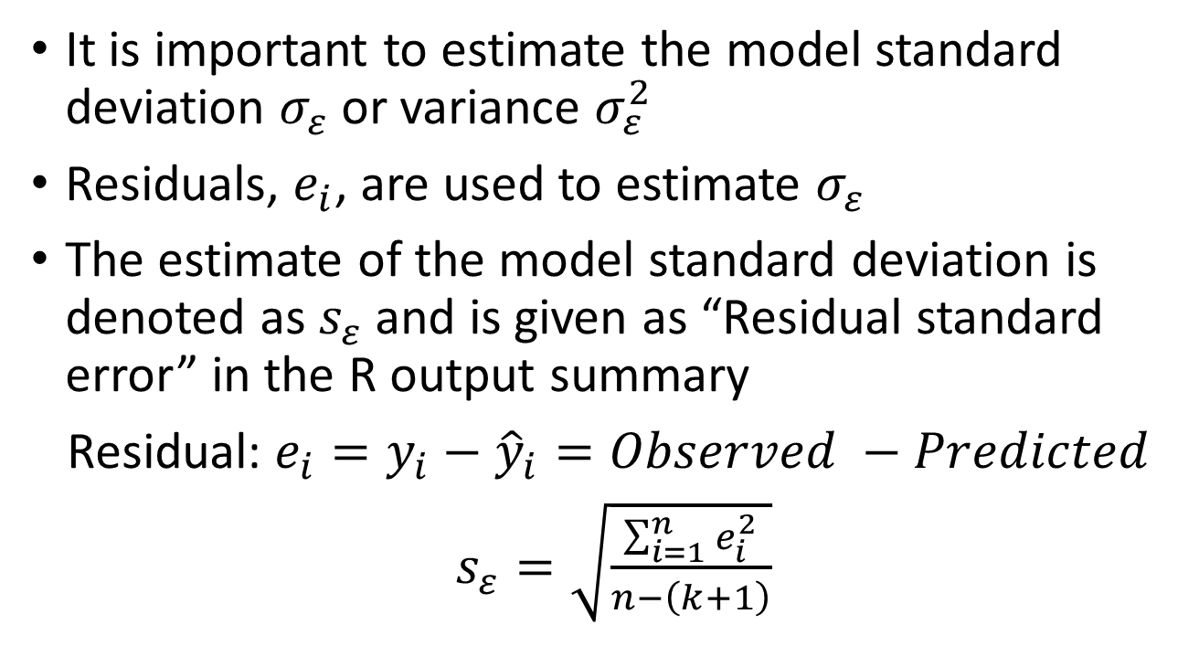
Model Standard Deviation
It is important to estimate the model standard deviation $σ_{ε}$ or variance $σ_{ε}^{2}$
Residuals, $e_{i}$, are used to estimate $σ_{ε}$
The estimate of the model standard deviation is denoted as $s_{ε}$ and is given as “Residual standard error” in the R output summary
Residual: $e_{i}=y_{i}−{\hat{y}}_{i}=Observed −Predicted$
$s_{ε}=\sqrt{\frac{\sum_{i=1}^{n}{e_{i}^{2}}}{n−\left(k+1\right)}}$

Slide 13
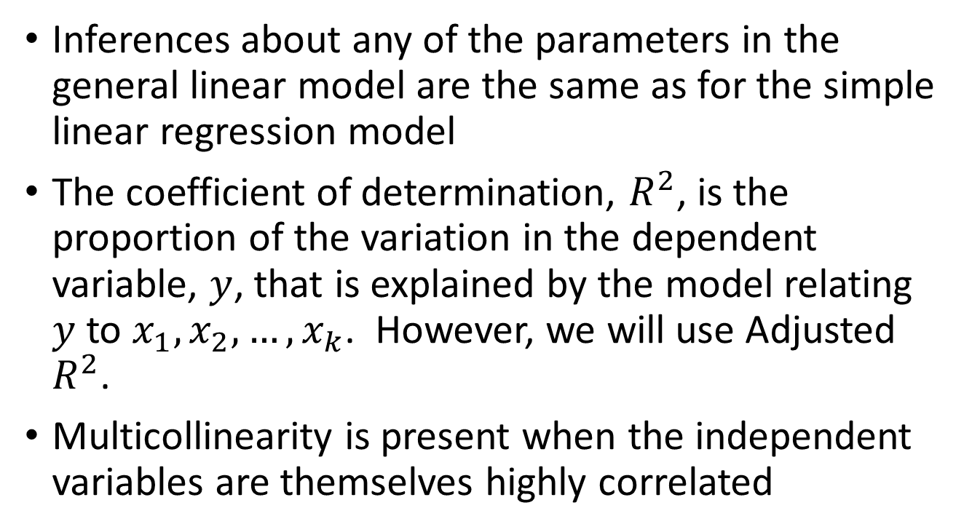
Section 12.4 Inferences in Multiple Regression
Inferences about any of the parameters in the general linear model are the same as for the simple linear regression model
The coefficient of determination, $R^{2}$, is the proportion of the variation in the dependent variable, $y$, that is explained by the model relating $y$ to $x_{1}, x_{2}, …, x_{k}$. However, we will use Adjusted $R^{2}$.
Multicollinearity is present when the independent variables are themselves highly correlated

Slide 14
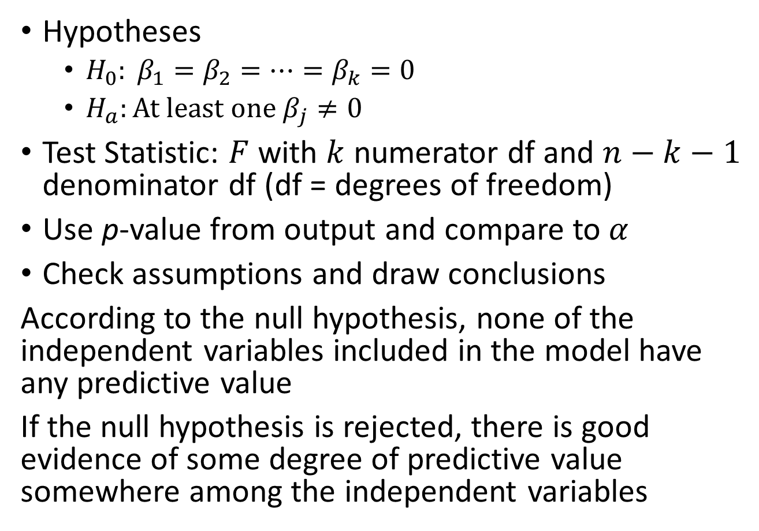
Overall Model Test
Hypotheses
$H_{0}: β_{1}=β_{2}=⋯=β_{k}=0$
$H_{a}:At least one β_{j}≠0$
Test Statistic: $F$ with $k$ numerator df and $n−k−1$ denominator df (df = degrees of freedom)
Use p-value from output and compare to $α$
Check assumptions and draw conclusions
According to the null hypothesis, none of the independent variables included in the model have any predictive value
If the null hypothesis is rejected, there is good evidence of some degree of predictive value somewhere among the independent variables

Slide 15
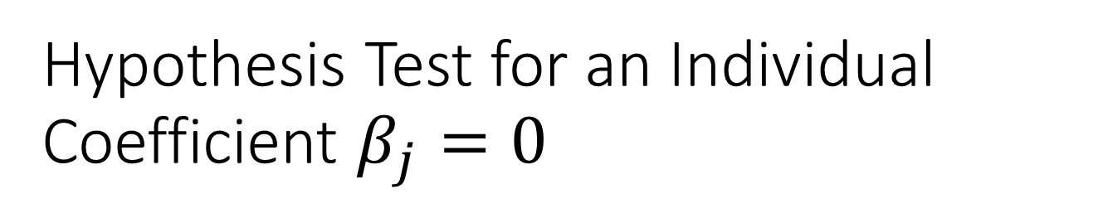
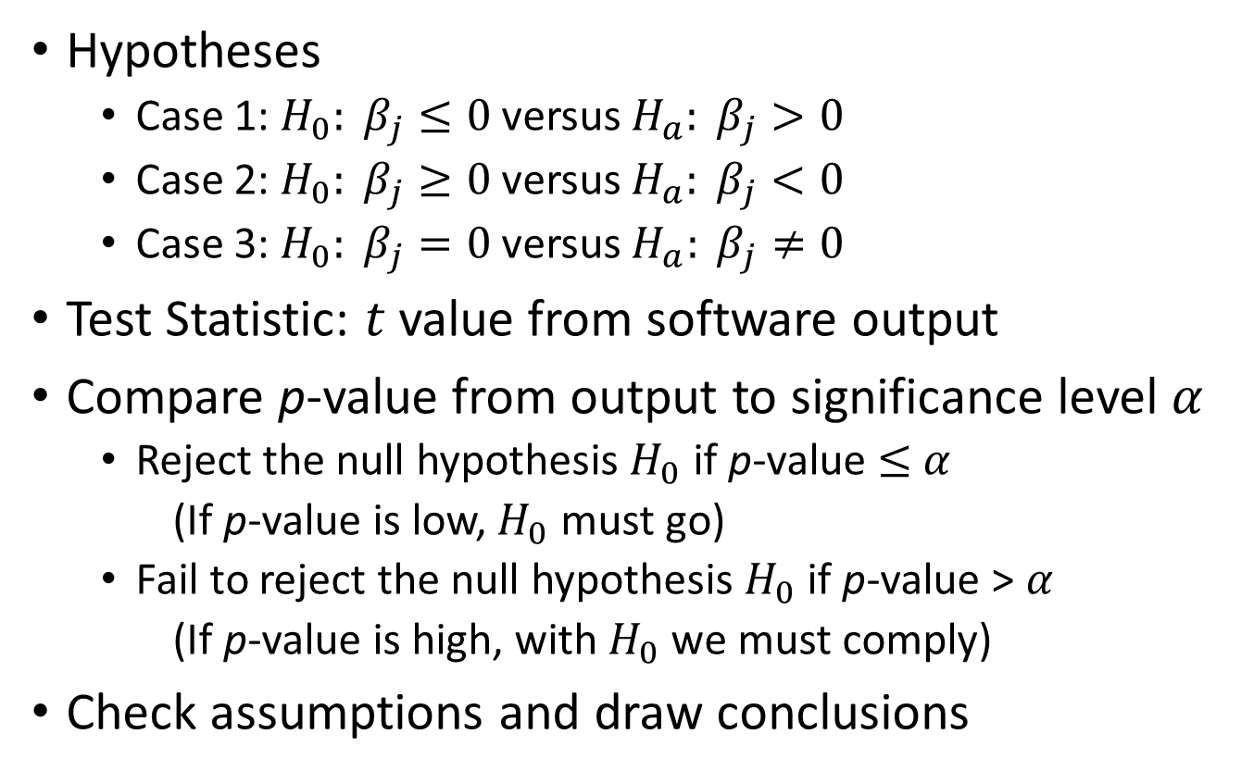
Hypothesis Test for an Individual Coefficient $β_{j}=0$
Hypotheses
Case 1: $H_{0}: β_{j}≤0$versus $H_{a}: β_{j}>0$
Case 2: $H_{0}: β_{j}≥0$versus $H_{a}: β_{j}<0$
Case 3: $H_{0}: β_{j}=0$versus $H_{a}: β_{j}≠0$
Test Statistic: $t$ value from software output
Compare p-value from output to significance level $α$
Reject the null hypothesis $H_{0}$ if p-value $≤$ $α$
(If p-value is low, $H_{0}$ must go)
Fail to reject the null hypothesis $H_{0}$ if p-value > $α$
(If p-value is high, with $H_{0}$ we must comply)
Check assumptions and draw conclusions

Slide 16
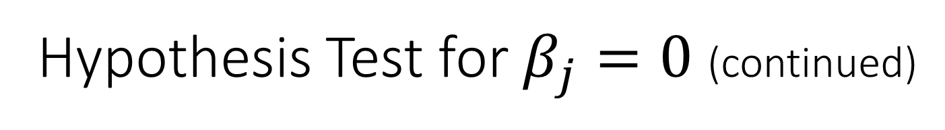
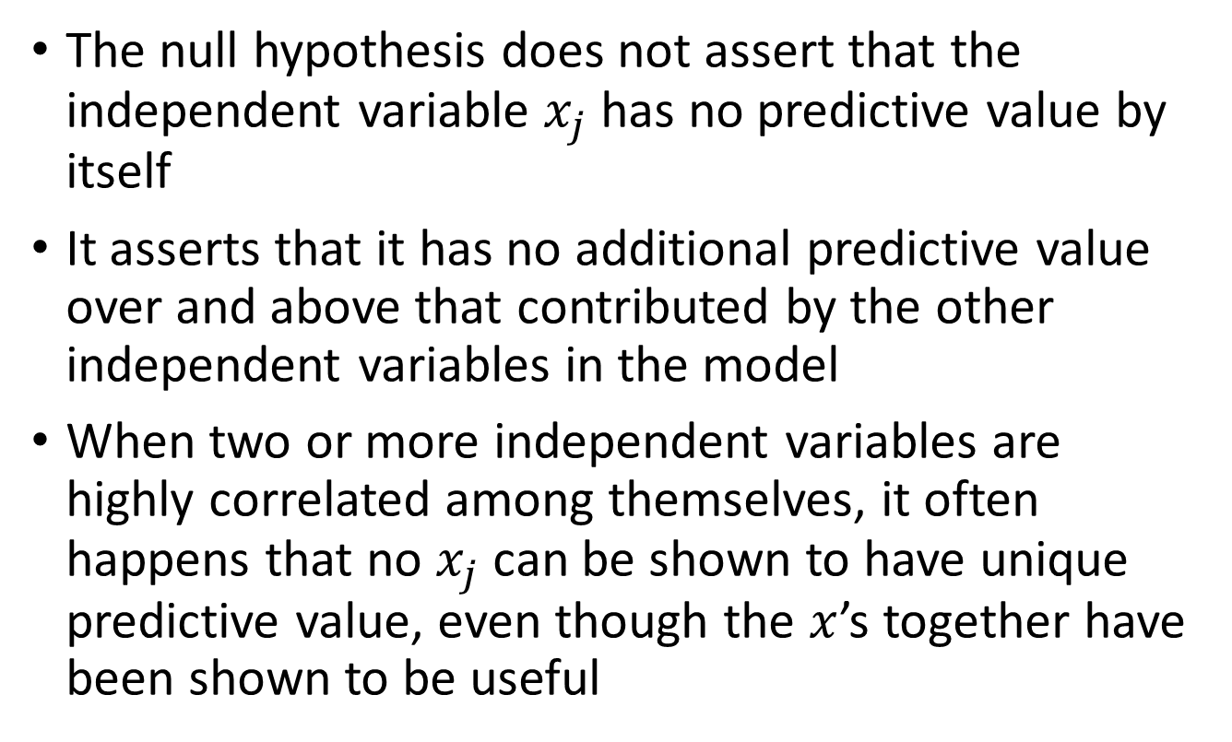
Hypothesis Test for $β_{j}=0$ (continued)
The null hypothesis does not assert that the independent variable $x_{j}$ has no predictive value by itself
It asserts that it has no additional predictive value over and above that contributed by the other independent variables in the model
When two or more independent variables are highly correlated among themselves, it often happens that no $x_{j}$ can be shown to have unique predictive value, even though the $x$’s together have been shown to be useful

Slide 17
Section 11.1 Introduction and Abstract of Research Study (Transformations Only)
For multiple regression, it may be necessary to transform the independent variables, dependent variable, or both
The text provides several graphs and “Steps for choosing a transformation”
The regression analysis is then performed on the transformed variables(s) as long as the assumptions are met for the analysis using the transformed variable(s)

Slide 18
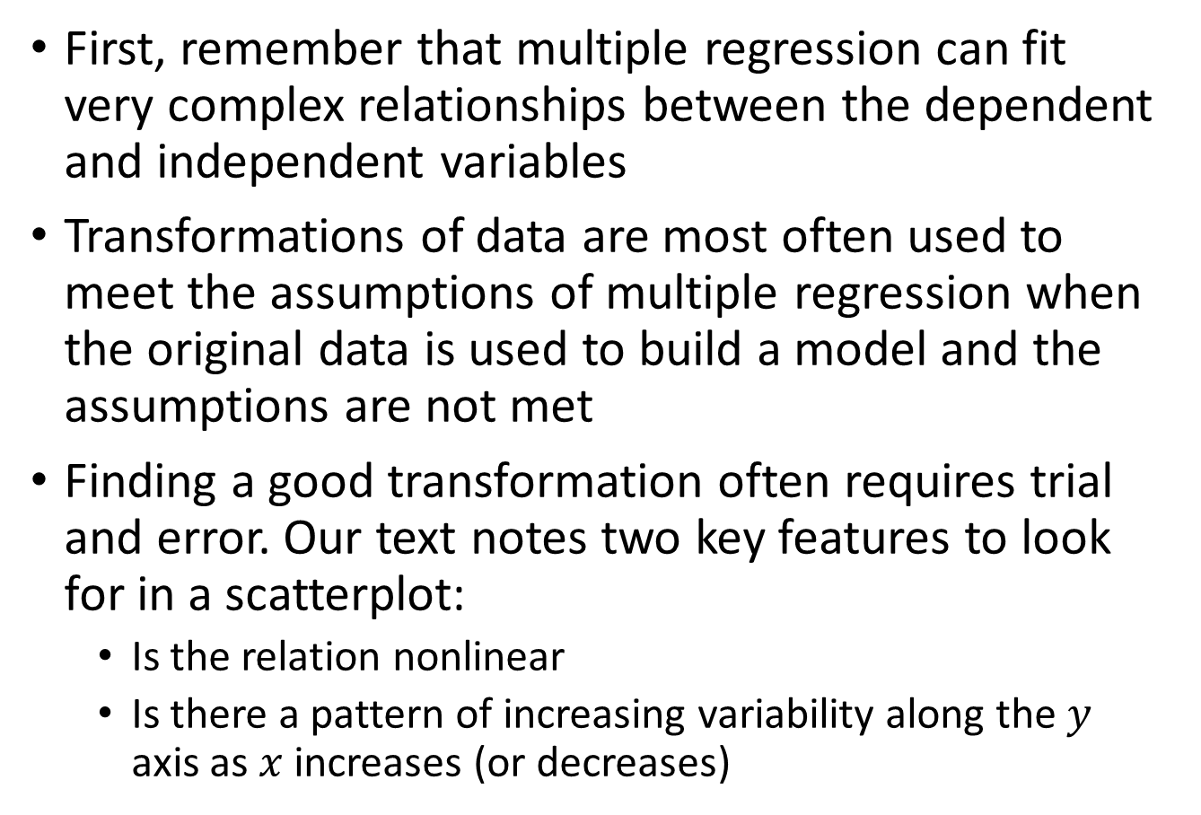
Transformations of Data
First, remember that multiple regression can fit very complex relationships between the dependent and independent variables
Transformations of data are most often used to meet the assumptions of multiple regression when the original data is used to build a model and the assumptions are not met
Finding a good transformation often requires trial and error. Our text notes two key features to look for in a scatterplot:
Is the relation nonlinear
Is there a pattern of increasing variability along the $y$ axis as $x$ increases (or decreases)

Slide 19
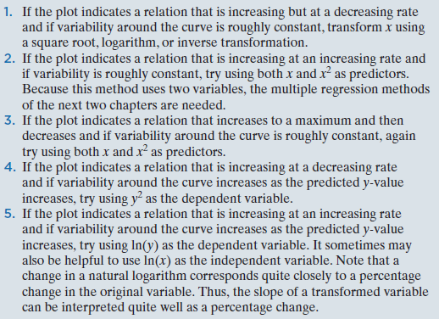
Steps for choosing a transformation
See out text on page 562 for corresponding plots

